Slide 1

Thread and Condition Variable
Computer System Engineering, Fall 2017. (IPADS, SJTU)
Lock with yield()
Yubin Xia

Slide 2
Producer–consumer problem
Case of cooperation and concurrency

Slide 3
Bounded Buffer between Producer & Consumer
2^{n}
0
2^{n}
0
Module A
Module B
OS
Very similar with the C/S model

Slide 4
Enforce Modularity for Bounded Buffer
Adopt the same message-passing paradigm in C/S
To enable communication while keep isolation
Like RPC
Share buffer in kernel
User mode cannot access the buffer directly
Applications use API to operate the buffer
Must transition to kernel mode to copy messages into/from the shared buffer

Slide 5
Bounded Buffer and its API
Bounded buffer: a buffer that stores (up to) N messages
Bounded buffer API
send (m)
m <- receive()

Slide 6
Enforce Modularity for Bounded Buffer
SEND() and RECEIVE()
Supervisor calls (e.g., system calls)
Copy the message from/to the thread's domain to/from the shared buffer
Programs running in kernel mode is written carefully
Transitions between user mode and kernel mode can be expensive

Slide 7
Virtual Communication Links
Producer and Consumer Problem
Sender must wait when buffer is full
Receiver must wait when buffer is empty
Need sequence coordination

Slide 8
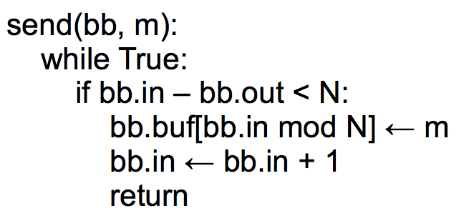
Bounded Buffer Send
Cannot switch the two
Notes:
Imagine that the buffer has zero elements in it. Program 1 has a
message to send. The if condition evaluates to True, and Program 1
increments bb.in. However, at the same time, Program 2 is trying to
read. Program 2's if-statement will also evaluate to true: right now,
bb.out = 0 and bb.in = 1. So Program 2 will try to read a message
from the buffer, but none has been written yet.

Slide 9
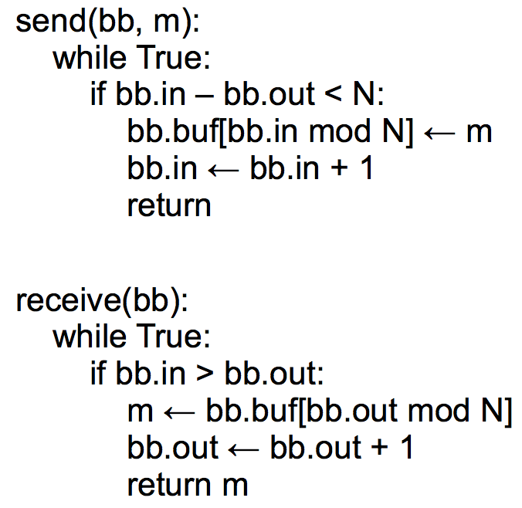
Bounded Buffer Send/Receive

Slide 10
Assumptions of the Previous Implementation
Single producer & Single consumer
Each on its own CPU
in and out do not overflow
read/write coherence (e.g., on cache)
in and out ensure before-or-after atomicity
The result of executing a statement becomes visible to other threads in program order
Compilers cannot optimize it
Notes:
2. if not, busy wait will just cost all CPU

Slide 11
Concurrency
This implementation works on two CPUs
One for a sender and one for a receiver
which is surprising!
Conventional wisdom tells us that if some resource is accessed by two (or more) CPUs at the same time, something might get wrong

Slide 12
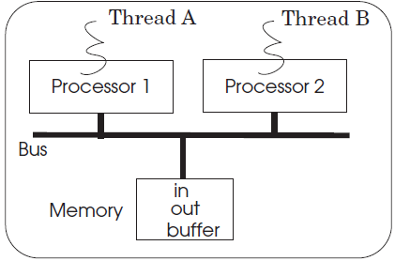
Multiple Senders
Multiple senders may send at the same time

Slide 13
Case 1
A
bb.in = 0, bb.out = 0
write m1 to buf[0]
set bb.in = 1
B
bb.in = 1, bb.out = 0
write m2 to buf[1]
set bb.in = 2
Everything works fine!

Slide 14
Case 2
A
bb.in = 0, bb.out = 0
write m1 to buf[0]
set bb.in = 1
B
bb.in = 0, bb.out = 0
write m2 to buf[0]
set bb.in = 1
m1 lost!

Slide 15
Send with Locking: Correct?
send(bb, message):
while True:
if bb.in – bb.out < N:
acquire(bb.send_lock)
bb.buf[bb.in mod N] <- message
bb.in <- bb.in + 1
release(bb.send_lock)
return
Notes:
Not correct. Concurrent senders will both think they can write.
One will get the lock and write, and then the other will get the lock,
but it might be that the first sender filled up the buffer (so that
the second shouldn't actually be writing).

Slide 16
Send with Locking: the Correct Version
send(bb, message):
acquire(bb.send_lock)
while True:
if bb.in – bb.out < N:
bb.buf[bb.in mod N] <- message
bb.in <- bb.in + 1
release(bb.send_lock)
return

Slide 17
Send with Locking: Another Version
send(bb, message):
while True:
acquire(bb.send_lock)
if bb.in – bb.out < N:
bb.buf[bb.in mod N] <- message
bb.in <- bb.in + 1
release(bb.send_lock)
return
release(bb.send_lock)

Slide 18
The Need for Yield()

Slide 19
The yield() System Call
When using locking, current thread is busy waiting for an event
Implementation of yield():
Suspend running thread: save stack pointer and page-table register
Choose new thread: round-robin fashion until we hit a RUNNABLE thread (perhaps the one that just called yield)
Resume thread to run: reload state all of this happens as an atomic action
Data structures
threads table, CPUs table, t_lock

Slide 20
send() with yield()
send(bb, msg):
acquire(bb.lock)
while True:
if bb.in – bb.out < N:
bb.buf[bb.in mod N] <- msg
bb.in <- bb.in + 1
release(bb.lock)
return
send(bb, msg):
acquire(bb.lock)
while True:
if bb.in - bb.out < N:
bb.buf[bb.in mod N] <- msg
bb.in <- bb.in + 1
release(bb.lock)
return
release(bb.lock)
yield()
acquire(bb.lock)
Note that this version of send() is incorrect.
We will first show YIELD() implementation.

Slide 21
YIELD() Implementation
yield():
// Suspend the running thread
// Choose a new thread
// Resume the new thread

Slide 22
YIELD() Implementation
yield():
acquire(t_lock)
id = id of current thread
threads[id].state = RUNNABLE
threads[id].sp = SP
// Choose a new thread
// Resume the new thread
release(t_lock)
Suspend
running thread
A table contains a list of all the current threads and some info about them, one per system
threads
t_lock
A lock protect the thread table (at least for now)

Slide 23
YIELD() Implementation
yield():
acquire(t_lock)
id = cpus[CPU].thread
threads[id].state = RUNNABLE
threads[id].sp = SP
// Choose a new thread
// Resume the new thread
release(t_lock)
Suspend
running thread
A table contains a list of all CPUs and the ID of the thread currently running on them, one per CPU
cpus
Question: why no cpu_lock needed?

Slide 24
YIELD() Implementation
yield():
acquire(t_lock)
id = cpus[CPU].thread
threads[id].state = RUNNABLE
threads[id].sp = SP
do:
id = (id + 1) mod N
while threads[id].state != RUNNABLE
// Resume new thread
release(t_lock)
Suspend
running thread
Choose new
thread
The state could be RUNNING, RUNNABLE (for now)

Slide 25
YIELD() Implementation
yield():
acquire(t_lock)
id = cpus[CPU].thread
threads[id].state = RUNNABLE
threads[id].sp = SP
do:
id = (id + 1) mod N
while threads[id].state != RUNNABLE
SP = threads[id].sp
threads[id].state = RUNNING
cpus[CPU].thread = id
release(t_lock)
Suspend
running thread
Choose new
thread
Resume new
thread
t_lock
Atomically set threads[ ].state and .sp
Atomically find a RUNNABLE thread and mark it RUNNING

Slide 26
Conditional Variables

Slide 27
Review: send() with Lock
send(bb, msg):
acquire(bb.lock)
while True:
if bb.in – bb.out < N:
bb.buf[bb.in mod N] <- msg
bb.in <- bb.in + 1
release(bb.lock)
return
send(bb, msg):
acquire(bb.lock)
while True:
if bb.in - bb.out < N:
bb.buf[bb.in mod N] <- msg
bb.in <- bb.in + 1
release(bb.lock)
return
release(bb.lock)
yield()
acquire(bb.lock)
Note that this version of send() is incorrect.

Slide 28
A Lot of Wasting Checks
send(bb, msg):
acquire(bb.lock)
while True:
if bb.in - bb.out < N:
bb.buf[bb.in mod N] <- msg
bb.in <- bb.in + 1
release(bb.lock)
return
release(bb.lock)
yield()
acquire(bb.lock)
Problem: a lot of unnecessary checking as well as a lot of acquiring locks
Better solution: the sender (receiver) just got woken up when the buffer is not full (empty)

Slide 29
Condition Variables
Condition Variable
Let threads wait for events
The threads get notified when the events occur
Condition variable API
WAIT(cv): yield processor and wait to be notified of cv
NOTIFY(cv): notify waiting threads of cv

Slide 30
Send with WAIT/NOTIFY (Incorrect Version)
send(bb, msg):
acquire(bb.lock)
while True:
if bb.in - bb.out < N:
bb.buf[bb.in mod N] <- msg
bb.in <- bb.in + 1
release(bb.lock)
return
release(bb.lock)
yield()
acquire(bb.lock)
send(bb, msg):
acquire(bb.lock)
while True:
if bb.in - bb.out < N:
bb.buf[bb.in mod N] <- msg
bb.in <- bb.in + 1
release(bb.lock)
notify(bb.not_empty)
return
release(bb.lock)
wait(bb.not_full)
acquire(bb.lock)
wait() will call yield()

Slide 31
Send with WAIT/NOTIFY
Do we really need a while loop with CV?
Strawman alternative: if buffer is full, wait() and then store message
Problem: many senders might wake up from wait() after just one receive()
Must re-check that there's still space after we re-acquired the lock
What happens if send() notifies but there's no receiver waiting?
No one gets woken up
But that's OK: a later receiver will re-check (in>out)

Slide 32
The Lost Notify Problem
Condition variable itself has no memory/state
wait() and then notify(): wait() returns
notify() and then wait(): wait() does not return
This is potentially prone to race conditions

Slide 33
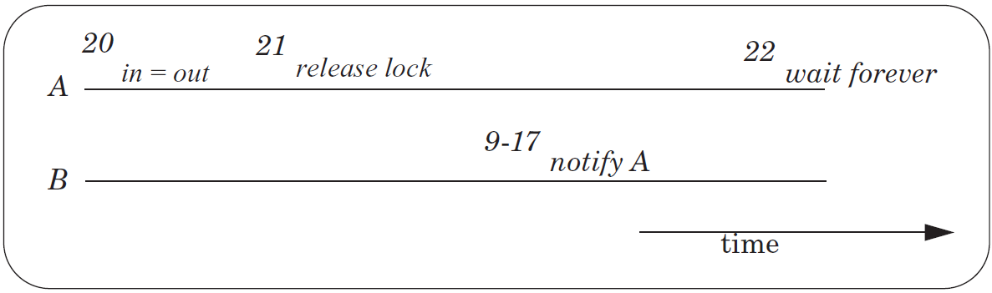
The Lost Notify Problem

Slide 34
New API: WAIT(bb.full, bb.lock)
Old API
WAIT(cv): yield processor and wait to be notified of cv
NOTIFY(cv): notify waiting threads of cv
New API
WAIT(cv, lock): release lock, yield CPU, wait to be notified
NOTIFY(cv): notify waiting threads of cv

Slide 35
New API: WAIT(bb.full, bb.lock)
send(bb, msg):
acquire(bb.lock)
while True:
if bb.in - bb.out < N:
bb.buf[bb.in mod N] <- msg
bb.in <- bb.in + 1
release(bb.lock)
notify(bb.not_empty)
return
release(bb.lock)
wait(bb.not_full)
acquire(bb.lock)
send(bb, msg):
acquire(bb.lock)
while True:
if bb.in - bb.out < N:
bb.buf[bb.in mod N] <- msg
bb.in <- bb.in + 1
release(bb.lock)
notify(bb.not_empty)
return
release(bb.lock)
wait(bb.not_full)
acquire(bb.lock)
wait(bb.not_full, bb.lock)

Slide 36
WAIT
send(bb, msg):
acquire(bb.lock)
while True:
if bb.in - bb.out < N:
bb.buf[bb.in mod N] <- msg
bb.in <- bb.in + 1
release(bb.lock)
notify(bb.not_empty)
return
wait(bb.not_full, bb.block)
wait(cv, lock):
acquire(t_lock)
release(lock)
threads[id].cv = cv
threads[id].state = WAITING
yield_wait()
release(t_lock)
acquire(lock)
Not yield()
Using t_lock to ensure the atomic of release lock and yield
The order of t_lock and lock matters

Slide 37
WAIT & NOTIFY
wait(cv, lock):
acquire(t_lock)
release(lock)
threads[id].cv = cv
threads[id].state = WAITING
yield_wait()
release(t_lock)
acquire(lock)
notify(cv):
acquire(t_lock)
for I = 0 to N-1:
if threads[i].cv == cv && threads[i].state == WAITING:
threads[i].state = RUNNABLE
release(t_lock)

Slide 38
Recall YIELD()
yield():
acquire(t_lock)
id = cpus[CPU].thread
threads[id].state = RUNNABLE
threads[id].sp = SP
do:
id = (id + 1) mod N
while threads[id].state != RUNNABLE
SP = threads[id].sp
threads[id].state = RUNNING
cpus[CPU].thread = id
release(t_lock)
Suspend
running thread
Choose new
thread
Resume new
thread

Slide 39
YIELD_WAIT()
yield_wait(): // called by wait()
acquire(t_lock)
id = cpus[CPU].thread
threads[id].state = RUNNABLE
threads[id].sp = SP
do:
id = (id + 1) mod N
while threads[id].state != RUNNABLE
SP = threads[id].sp
threads[id].state = RUNNING
cpus[CPU].thread = id
release(t_lock)
wait(cv, lock):
acquire(t_lock)
release(lock)
threads[id].cv = cv
threads[id].state = WAITING
yield_wait()
release(t_lock)
acquire(lock)
The t_lock has already been hold by wait()
Current thread should not be RUNNABLE

Slide 40
YIELD_WAIT()
yield_wait(): // called by wait()
id = cpus[CPU].thread
threads[id].sp = SP
do:
id = (id + 1) mod N
while threads[id].state != RUNNABLE
SP = threads[id].sp
threads[id].state = RUNNING
cpus[CPU].thread = id
wait(cv, lock):
acquire(t_lock)
release(lock)
threads[id].cv = cv
threads[id].state = WAITING
yield_wait()
release(t_lock)
acquire(lock)
Problem: what if nothing is RUNNABLE?
yield_wait() will keep looping forever, while holding t_lock.
Other CPUs cannot acquire t_lock, even if they want to do a notify! ==> deadlock!

Slide 41
YIELD_WAIT()
yield_wait(): // called by wait()
id = cpus[CPU].thread
threads[id].sp = SP
do:
id = (id + 1) mod N
release(t_lock)
acquire(t_lock)
while threads[id].state != RUNNABLE
SP = threads[id].sp
threads[id].state = RUNNING
cpus[CPU].thread = id
wait(cv, lock):
acquire(t_lock)
release(lock)
threads[id].cv = cv
threads[id].state = WAITING
yield_wait()
release(t_lock)
acquire(lock)
Problem: Once yield_wait() releases t_lock, another CPU can run our current thread.
So now two CPUs have their SP pointing to the same thread's stack!
Can result in the stack being corrupted!
Notes:
SP currently points to the original thread's stack -- call it thread A.
Between release and acquire, another CPU could run thread A. This
means that two CPUs will have their stack pointer pointing to thread
A's stack. This is a very easy way for A's stack to get corrupted.

Slide 42
YIELD_WAIT()
yield_wait(): // called by wait()
id = cpus[CPU].thread
threads[id].sp = SP
SP = cpus[CPU].stack
do:
id = (id + 1) mod N
release(t_lock)
acquire(t_lock)
while threads[id].state != RUNNABLE
SP = threads[id].sp
threads[id].state = RUNNING
cpus[CPU].thread = id
wait(cv, lock):
acquire(t_lock)
release(lock)
threads[id].cv = cv
threads[id].state = WAITING
yield_wait()
release(t_lock)
acquire(lock)

Slide 43
Preemption
For thread scheduling

Slide 44
Preemptive Scheduling
Non-preemptive Scheduling
A thread continues to run until it gives up its processor
Cooperative Scheduling (cooperative multitasking)
Every thread is supposed to call YIELD periodically
Preemptive Scheduling
The thread manager force a thread to give up its processor after a time interval

Slide 45
Implement Preemptive Scheduling
Set the interval timer of a clock device
When the timer expires
The clock triggers an interrupt
Switching to kernel mode in the processor layer to invoke clock interrupt handler
The clock interrupt handler invokes an exception handler
Runs in the thread layer
Forces the currently running thread to yield

Slide 46
Timer Interrupt Handler
timer_interrupt():
push PC // done by CPU
push registers // this is not a function call;
// cannot assume compiler saves registers
yield()
pop registers
pop PC

Slide 47
YIELD_WAIT()
yield_wait(): // called by wait()
id = cpus[CPU].thread
threads[id].sp = SP
SP = cpus[CPU].stack
do:
id = (id + 1) mod N
release(t_lock)
acquire(t_lock)
while threads[id].state != RUNNABLE
SP = threads[id].sp
threads[id].state = RUNNING
cpus[CPU].thread = id
wait(cv, lock):
acquire(t_lock)
release(lock)
threads[id].cv = cv
threads[id].state = WAITING
yield_wait()
release(t_lock)
acquire(lock)
Problem: What happens if timer interrupt occurs when CPU is running yield / yield_wait?
Since t_lock is already locked, When timer tries to call yield(), acquire(t_lock) will hang forever!

Slide 48
YIELD_WAIT()
yield_wait(): // called by wait()
id = cpus[CPU].thread
threads[id].sp = SP
SP = cpus[CPU].stack
do:
id = (id + 1) mod N
release(t_lock)
enable_interrupt()
disable_interrupt()
acquire(t_lock)
while threads[id].state != RUNNABLE
SP = threads[id].sp
threads[id].state = RUNNING
cpus[CPU].thread = id
wait(cv, lock):
disable_interrupt()
acquire(t_lock)
release(lock)
threads[id].cv = cv
threads[id].state = WAITING
yield_wait()
release(t_lock)
enable_interrupt()
acquire(lock)
Problem: if timer interrupt comes, we would put the wrong thread to sleep!

Slide 49
YIELD_WAIT()
yield_wait(): // called by wait()
id = cpus[CPU].thread
cpus[CPU].thread = null
threads[id].sp = SP
SP = cpus[CPU].stack
do:
id = (id + 1) mod N
release(t_lock)
enable_interrupt()
disable_interrupt()
acquire(t_lock)
while threads[id].state != RUNNABLE
SP = threads[id].sp
threads[id].state = RUNNING
cpus[CPU].thread = id
wait(cv, lock):
disable_interrupt()
acquire(t_lock)
release(lock)
threads[id].cv = cv
threads[id].state = WAITING
yield_wait()
release(t_lock)
enable_interrupt()
acquire(lock)

Slide 50
Summary
Threads
Virtualize a processor so that we can share it among programs
yield() allows the kernel to suspend the current thread and resume another
Condition Variables
Provide a more efficient API for threads
Threads wait for an event and are notified when it occurs
wait() requires a new version of yield(), yield_wait()
Preemption
Forces a thread to be interrupted
So that do not have to rely on programmers correctly using yield()
Requires a special interrupt and hardware support to disable other interrupts

Slide 51
Understanding The Code In Book

Slide 52
Thread Layer and Processor Layer
A thread runs in thread layer
A thread calls YIELD, enters processor layer
Saves the state of the running thread
General purpose regs + PC + SP + CR3
Chose another runnable thread
Exit the processor layer and enter thread layer
The new thread runs in thread layer

Slide 53
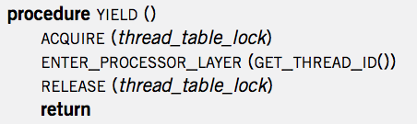
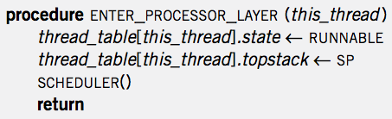
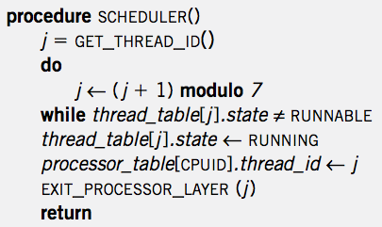

Context Switch
YIELD
ENTER
SCHED
EXIT
YIELD
YIELD
ENTER
SCHED
EXIT
YIELD
App
APP
APP
YIELD
YIELD
YIELD
YIELD
SP-1
ENTER
ENTER
SP-2
ENTER
ENTER
SP-2
SP-1
SCHED
SCHED
EXIT
EXIT
Notes:
Question-1: where is the point of context switch?
Question-2: why not save the PC of a thread?

Slide 54
Creating a Thread
ALLOCATE_THREAD
Allocate a new stack
Push address of EXIT_THREAD() as return address
Push address of starting_procedure as return address
starting_procedure is the start address of a thread
Initialize an entry in thread_table
Set state to RUNNABLE
Stack of a Thread
EXIT_THREAD
starting_procedure

Slide 55
Start the Scheduler
Processor Thread
Create a separate thread for each processor first
Its stack is not used for most of the time
Only used when running scheduler()

Slide 56
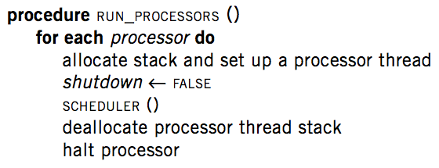
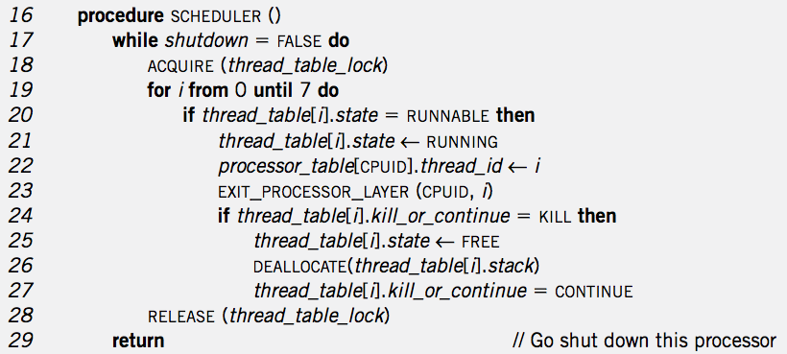
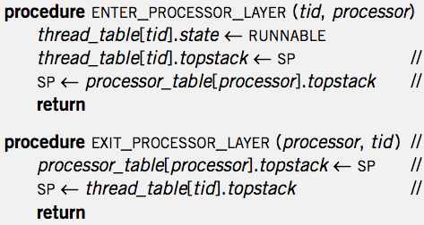
RUN_PROCESSOR
& Create Thread
Thread Create
RUN_PROCESSOR
EXIT_T
MAIN
APP
SCHED
EXIT_P

Slide 57
Thread Exit
1 procedure EXIT_THREAD()
2 ACQUIRE (threadtable_lock)
3 threadtable[tid].kill_or_continue ← KILL
4 ENTER_PROCESSOR_LAYER (GET_THREAD_ID (), CPUID)

Slide 58
Destroy a Thread
DESTROY_THREAD
One thread kills another thread
Problem: the target thread may be running, thus the calling thread cannot just free its resource
Solution: asynchronization: set KILL and return
Wait for the thread to be destroyed when SCHEDULER

Slide 59
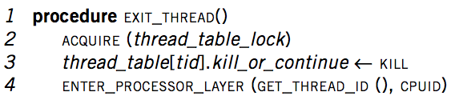
Thread Exit
Thread
Exit
APP
APP
EXIT_T
SCHED
YIELD
ENTER_P
EXIT_P
EXIT_P
ENTER_P

Slide 60
The New Scheduler()
16 procedure SCHEDULER ()
17 while shutdown = FALSE do
18 ACQUIRE (threadtable_lock)
19 for i from 0 until 7 do
20 if threadtable[i].state = RUNNABLE then
21 threadtable[i].state ← RUNNING
22 processor_table[CPUID].thread_id ← i
23 EXIT_PROCESSOR_LAYER (CPUID, i)
24 if threadtable[i].kill_or_continue = KILL then
25 threadtable[i].state ← FREE
26 DEALLOCATE(threadtable[i]. stack)
27 threadtable[i]. kill_or_continue = CONTINUE
28 RELEASE (threadtable_lock)
29 return // Go shut down this processor

Slide 61
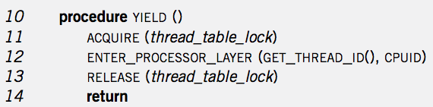
Context Switch
YIELD
ENTER
SCHED
EXIT
YIELD
YIELD
ENTER
SCHED
EXIT
YIELD
App
MAIN
APP
APP
MAIN
YIELD
SCHED
SCHED
YIELD
YIELD
SCHED
SCHED
SCHED
YIELD
ENTER
EXIT
EXIT
ENTER
ENTER
EXIT
EXIT
SP-1
SP-2
SP-2
ENTER
SP-1
SP of Processor Thread
SP of Processor Thread

Slide 62
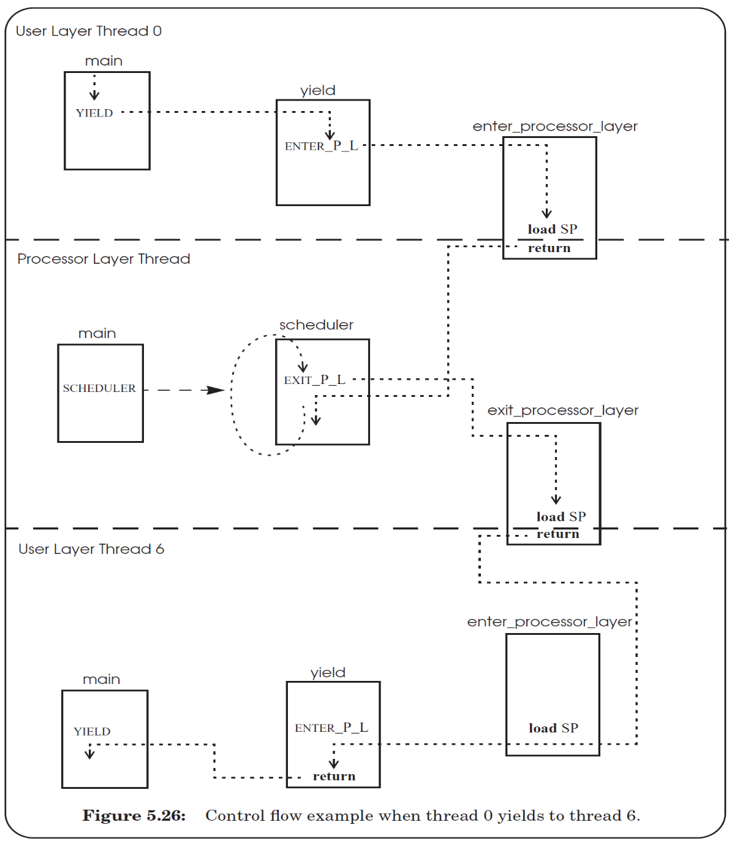

Slide 63
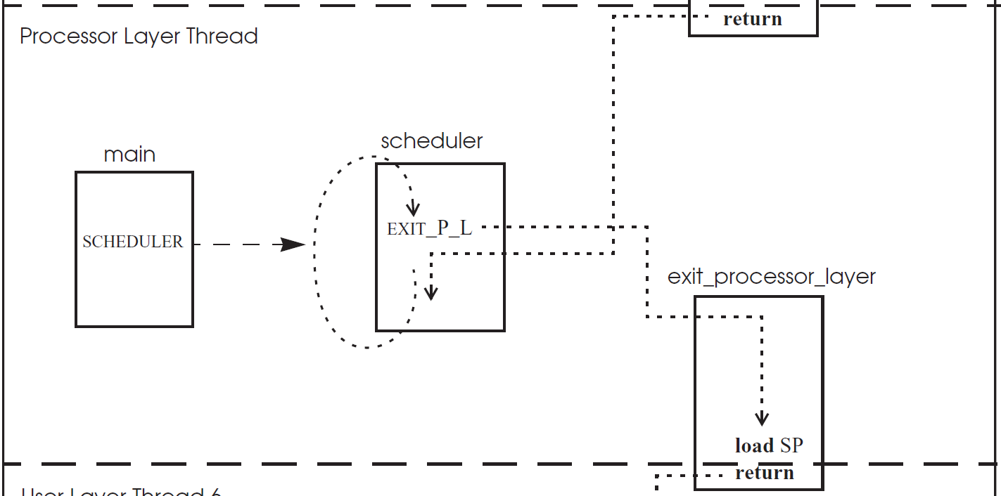

Slide 64
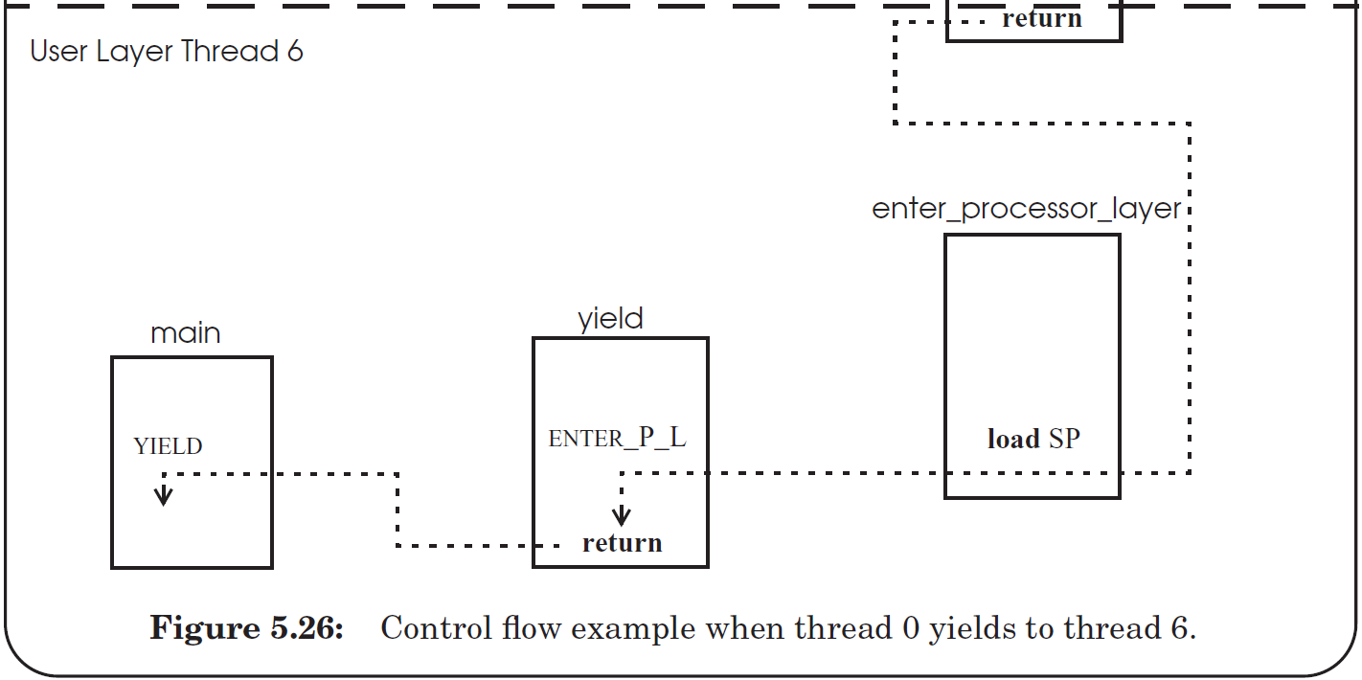

Slide 65
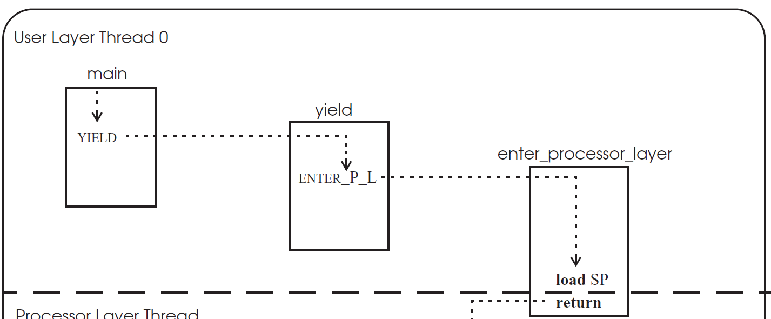

Slide 66
thread_table_lock
1
2
11
12
3
4
7
8
5
6
9
10

Slide 67
thread_table_lock
1
2
3
4
5
Stack changes to
processor thread
6
7
8
9
10
11
Stack changes back
12

Slide 68
First time of a thread
1
2
3
4
5
Stack changes to
processor thread
6
7
8
Q: still hold the lock?
9
10
11
start_procedure()
Stack changes back
Notes:
Answer: when create a new thread, the stack of the thread must be initialized to include YIELD(), and push the return address to the middle of YIELD(), so that when after return, the new thread will first release the lock, just as the previous slide. Then return again to the start_procedure (by pushing the address to the stack too).

Slide 69
Eventcount & Sequencer

Slide 70
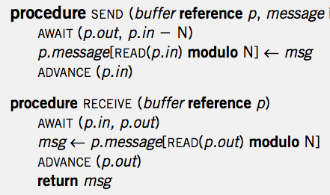
Single Sender and Single Receiver

Slide 71
4 Primitives
AWAIT (eventcount, value)
ADVANCE (eventcount)
TICKET (sequencer)
READ (eventcount or sequencer)

Slide 72
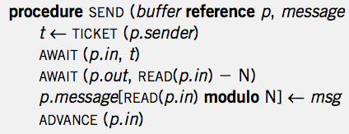
Multiple Senders and Single Receiver
No loop! Is it OK?

Slide 73
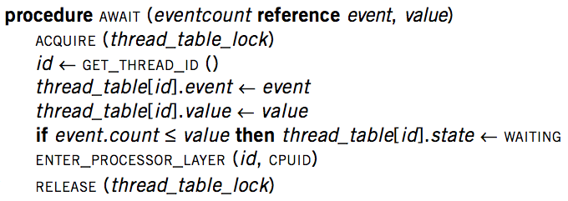
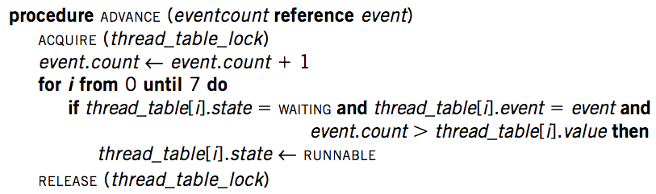
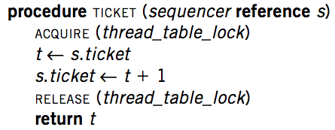
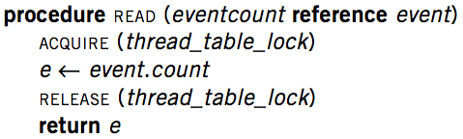
Implementation

Slide 74
Primitives for Sequence Coordination
AWAIT (eventcount, value) is a before-or-after action
Compares eventcount to value
If eventcount exceeds value
AWAIT returns to its caller.
If eventcount is less than or equal to value
Changes the state of the calling thread to WAITING
Places value and the name of eventcount in this thread's entry in the thread table
Yields its processor

Slide 75
Primitives for Sequence Coordination
ADVANCE (eventcount) is a before-or-after action
Increments eventcount by one
Searches the thread table for threads that are waiting on this eventcount
For each one it finds,
If eventcount now exceeds the value for which that thread is waiting
Changes that thread's state to RUNNABLE

Slide 76
Primitives for Sequence Coordination
TICKET (sequencer) is a before-or-after action
Returns a non-negative value that increases by one on each call
Two threads concurrently calling TICKET on the same sequencer
Receive different values
The ordering of the values returned corresponds to the time ordering of the execution of TICKET

Slide 77
Primitives for Sequence Coordination
READ (eventcount or sequencer) is a before-or-after action
Returns to the caller the current value of the variable
Having an explicit READ procedure is to assure before-or-after atomicity for eventcounts and sequencers whose value may grow to be larger than a memory cell

Slide 78
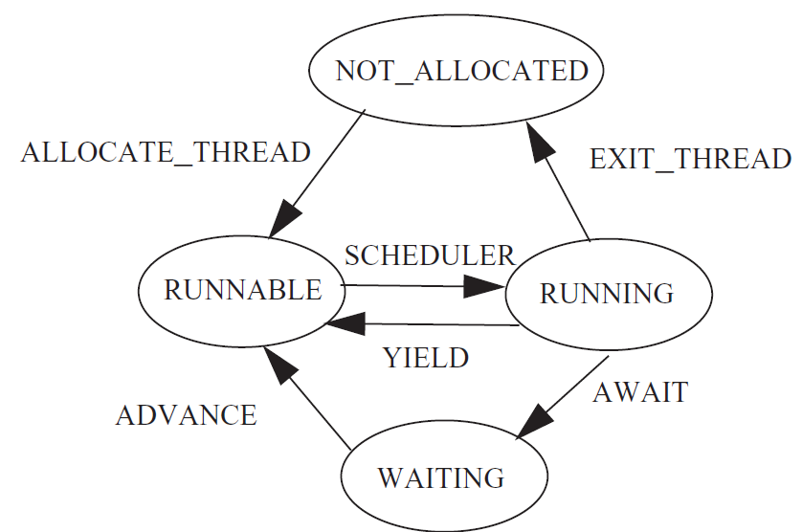
Thread State Diagram

